Slide 1

Decoding of motor termination in Imaged movement
Elisabetta Pagliara, Marco Milano, Giammarco Pacifico (Project 1)
Brain Computer Interaction – EE514

Slide 2

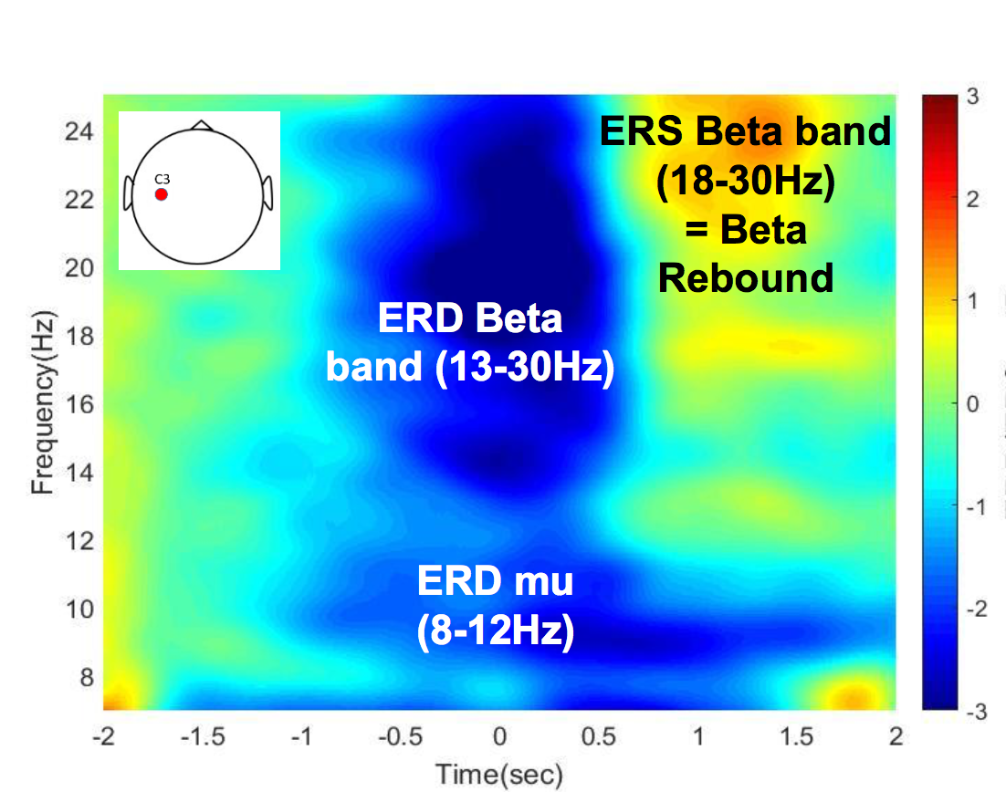
Project Description
Performing Kinesthetic Motor Imagery (MI)
What happens to the brain activity (record from 16 electrodes-cap)?
Why studying Kinesthetic MI?
Beta rebound could be used to decode when the use wants to stop motor imagery
Notes:
It has been observed that preceding movement onset and during movement execution, a decrease of power can be detected in mu band (8-12 Hz) as well as an increase of power in beta band (13-30 Hz), called beta rebound, over the contralateral sensorimotor cortex.

Slide 3
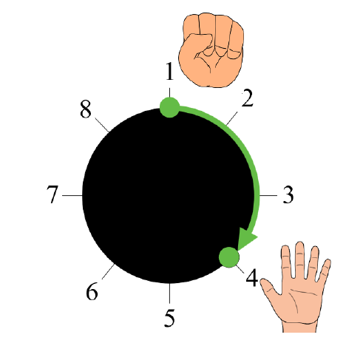
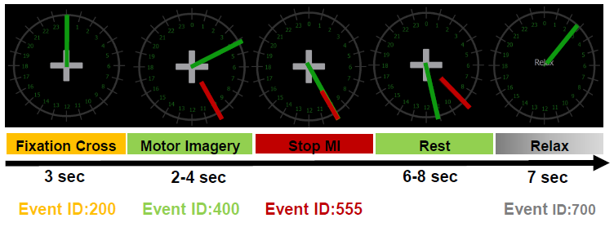
Protocol
START
END
4 runs (cue-based) of 30 trials of 10 sec plus 7 sec of relax each.
Beta rebound
Notes:
Changes in the brain rhythms are observed in the sensory-motor area of brain during planning and execution of movements. Indeed, it has been observed that preceding movement onset and during movement execution, a decrease of power can be detected in mu band (8-12 Hz) as well as in beta band (13-30 Hz) over the contralateral sensorimotor cortex (Pfurtscheller & Lopes Da Silva, 1999). Additionally, the beta band presents an increase of power known as the beta rebound, which generally occurs after movement termination and that can last for a second (Thatcher, Sato, Kufta, & Hallett, 1994). This beta rebound does not necessarily depend on motor cortex output and muscle activation since this beta rebound has been also reported in motor imagery (MI) and it is thought to reflect a short-lasting state of deactivation or inhibition of motor cortex networks

Slide 4
EEG correlates - Methods

Slide 5
EEG correlates - Methods
Concatenation of all runs for each subject
Comparison of two different spatial filters: Laplacian filter and CAR filter
Epoching of the data based on the event type and the chosen time before and after the selected event
Baseline (-3; 3)
Motor Imagery initiation (-4; 2)
Motor Imagery termination (-3; 3)
Pwelch on car data to obtain the periodogram to compare baseline and Motor Imagery
win=512, noverlap=0.5*512, frequency=500 Hz, sample rate=512 Hz
Spectrogram on the most relevant channels
Grand average over the three subjects
Topoplots in alpha band (8-12 Hz) and beta band (13-30 Hz) for both onset and offset, using the a 2 seconds window (-1:0.25:+1) with respect to the event alignment

Slide 6
EEG correlates - Results

Slide 7
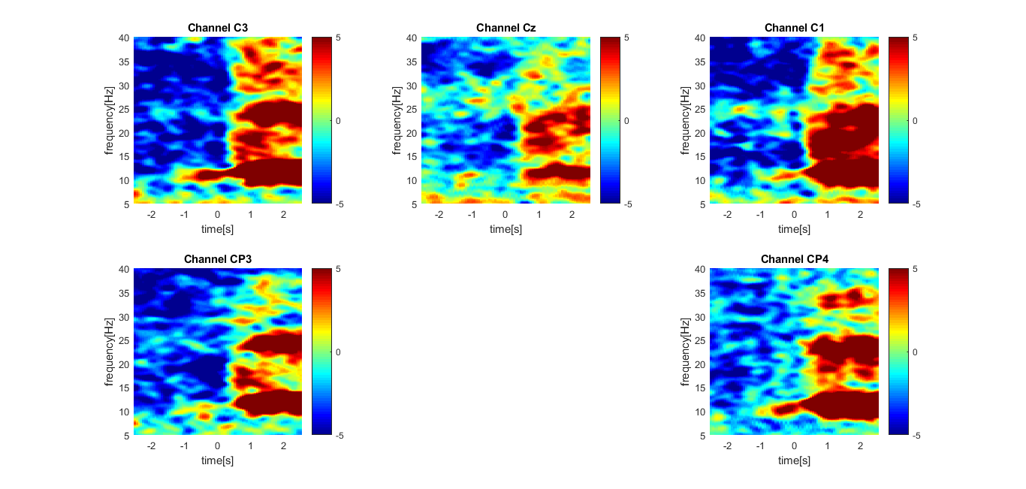
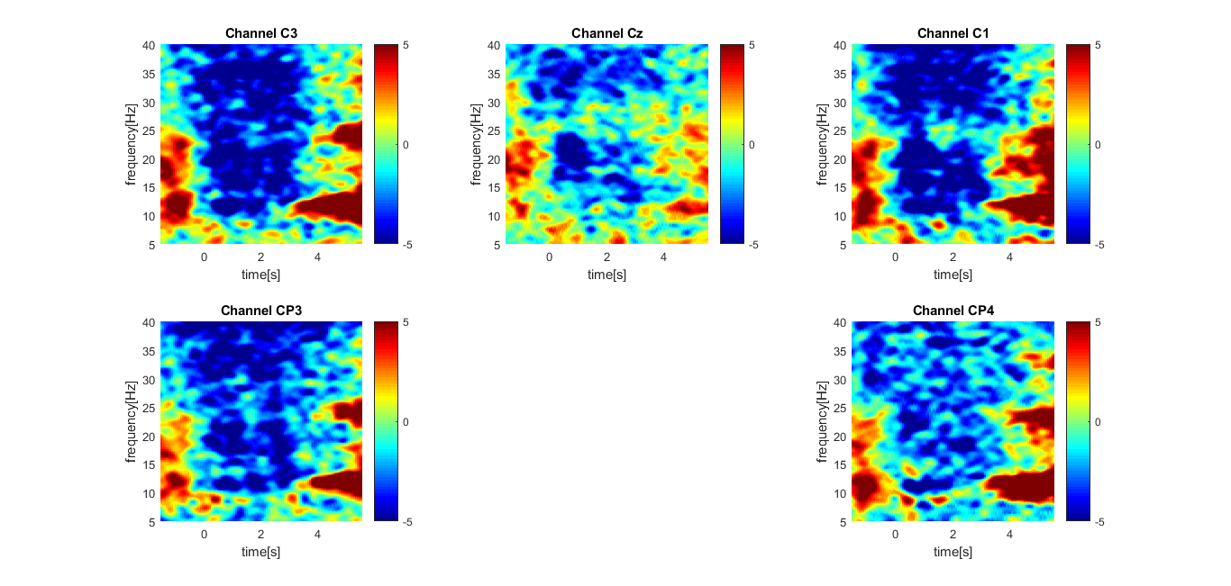
Spectrogram offset and onset CAR - ak4
The presence of the beta rebound is clearly visible for C1, C3 and CP4 but a sort of “alpha rebound” is also present at lower frequencies

Slide 8
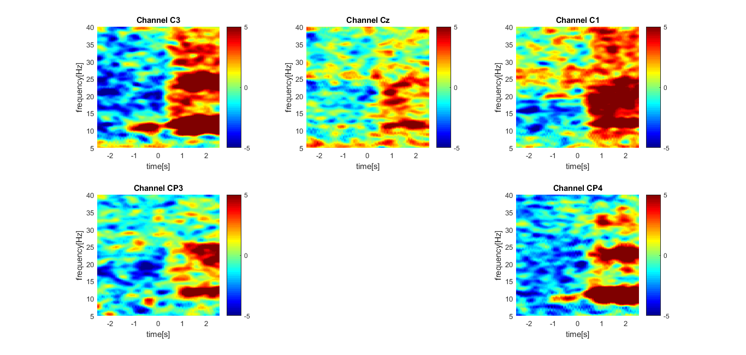
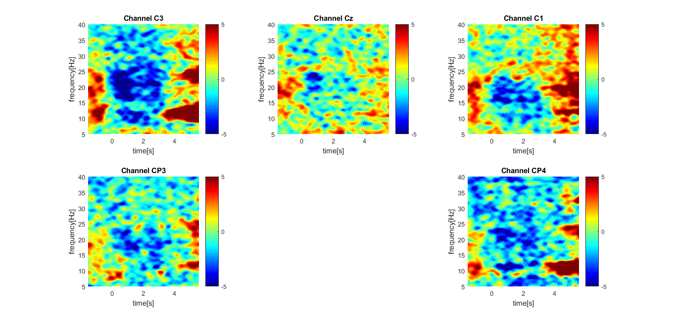
Spectrogram offset and onset Laplacian - ak4
Compared to CAR filter, Laplacian shows less evident representation of ERD events in all the channels. Therefore, CAR has been chosen for the subsequent analyses.

Slide 9
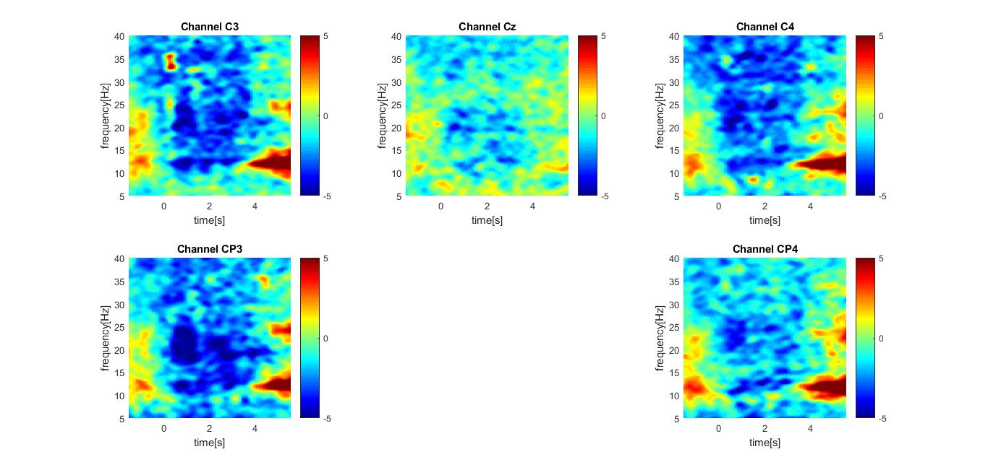
Grand average over all three students - CAR (onset)
Events (ERD in blue and ERS in red) are visible in all the grand averaged plots for onset

Slide 10
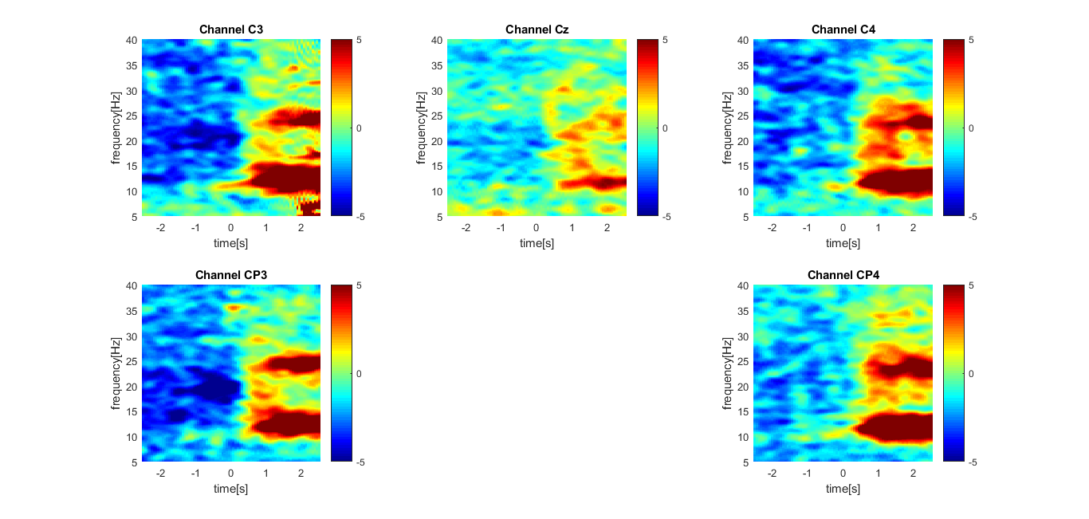
Grand average over all three students - CAR (offset)
Events (ERD in blue and ERS in red) are visible in all the grand averaged for the offset
Notes:
As expected, the beta rebound is particularly visible with the offset boundaries.

Slide 11
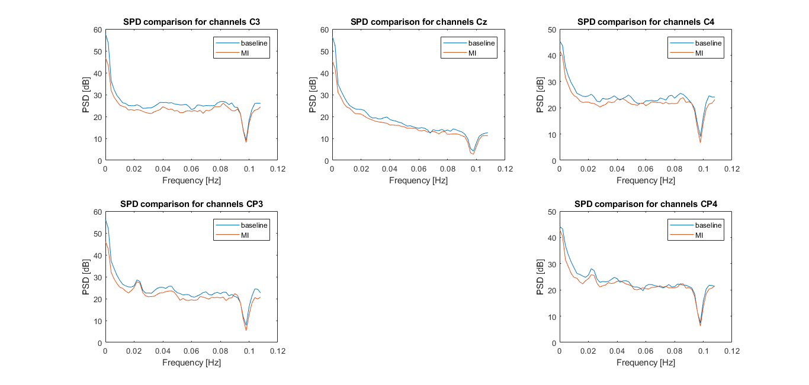
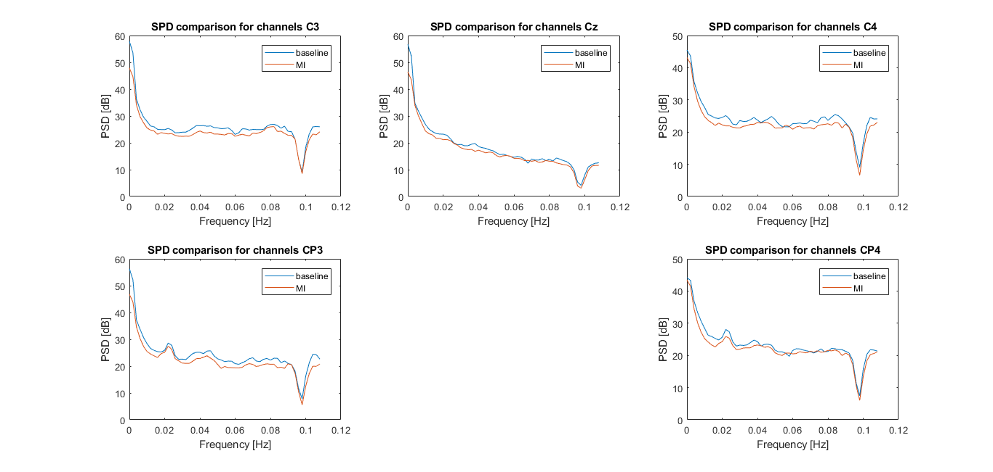
Periodogram (Pwelch) CAR offset/onset ak5
The periodogram shows the PSD depending on the frequency. We only showed the region of interest until 50 Hz. The presence of two bumps in the alpha band can be seen in the most relevant channels when comparing baseline and MI

Slide 12
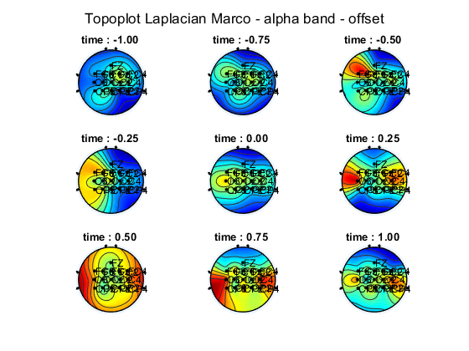
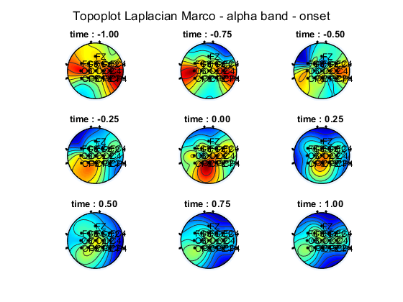
Topoplot alpha band - ak4
A decrease in the alpha band can be seen after the onset alignment and during the motor imagery. Moreover, a considerable increase is visible after the MI termination, during the relax phase

Slide 13
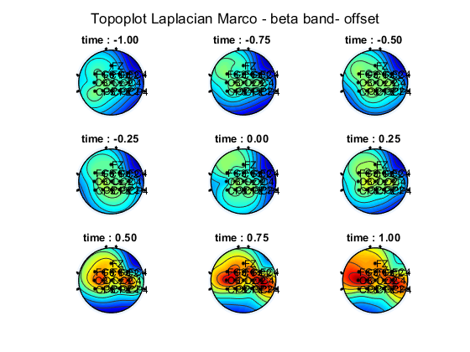
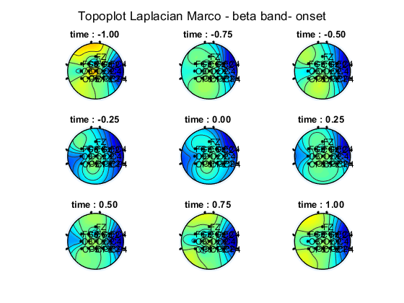
Topoplot beta band - ak4
The presence of the beta rebound is evident after the MI termination while lower power is visible during the MI initiation

Slide 14
Pattern Classification - Methods

Slide 15
Pattern Classification - Methods
4 runs (4∙30=120 trials) per subject
Spatial filtering: CAR. Temporal filtering: None.
Performed spectrogram on the whole signal (for each run)
4:2:40 Hz =>19 intervals
16 channels
Divided the signal into 1 second long windows with a shift of 0.0625 s
Epoching on :
Motor Imagery Initiation => Event ID: 555 [ -2,0 ] (sec) => Manually (re)assigned label 400
Motor Imagery Termination => Event ID: 555 [0.5,2.5] (sec)
=> We obtained 17 windows for each trial for each type of event (i.e. 17 ∙ 2 = 34)
We concatenated the runs
=> 120 ∙ 34 = 4080 samples with 304 features
Classifier had to distinguish between two classes: ERD (MI initation) and ERS (MI Termination)
=> 304 different features (PSD)

Slide 16
Methods Classifier
Divided into 75% training - 25% testing
CV on training but with temporal…. partition
Normalization with zscore on training folds and “projection” on validation folds
We tried PCA but didn’t get good results
Hyperparameters:
Type of classifier (linear, diaglinear, diagquadratic)
Number of features (we tried from 1 to 304 but in the end chose among 1:20)
(Number of PCs => 0)
=> Feature selection with Fisher’s score
=> Hyperparameter selection based on class error (of course on validation fold!) averaged over folds

Slide 17
Methods Classifier
How to evaluate the capability?
=> Retraining on the whole training+validation set (but without CV), with the hyperparameters found before
For features: only the number of features is fixed, but of course which are the actual features to take is determined by retraining
=> Test on the separate 30% test set
Metrics:
- ROC curve
- confusion matrix
- class error

Slide 18
Pattern Classification - Results

Slide 19
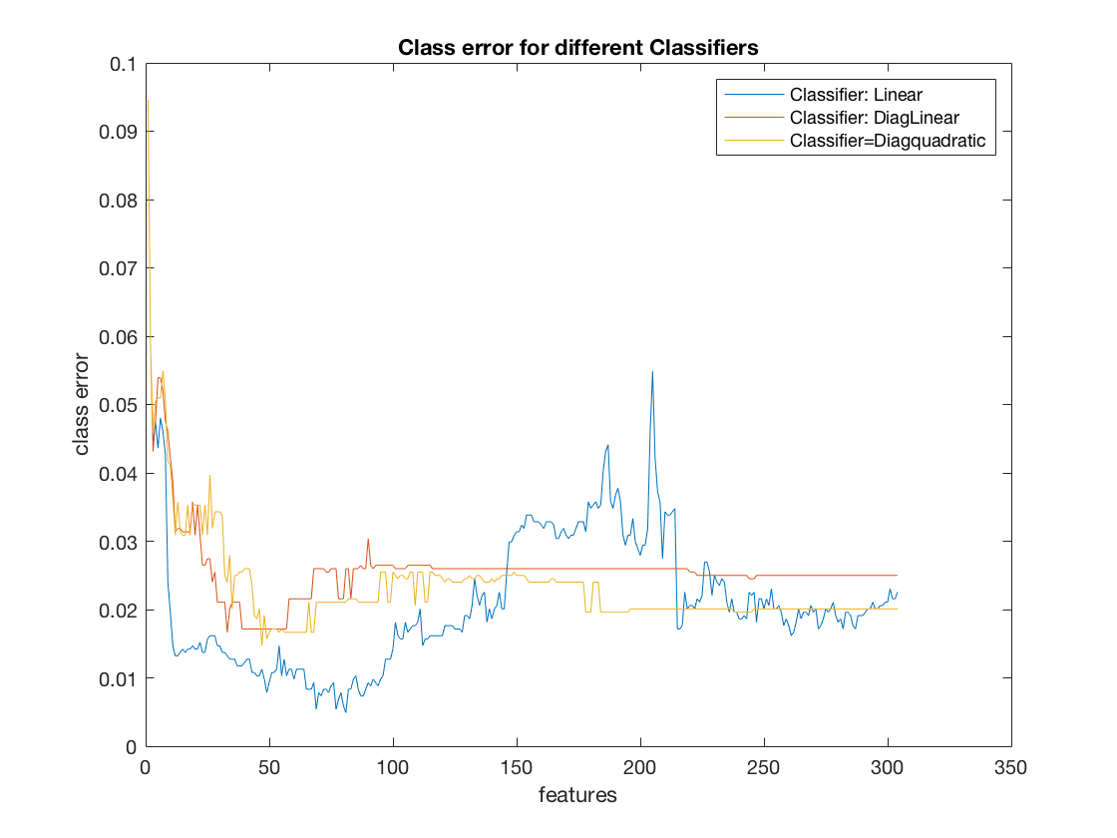
Hyperparameters selection
Hyperparameters selected:
Classifier type:
N_{sel} =
linear
(for all 3 subjects)
13 (for ak4)
20 (for ak5, ak6)
Class errors - ak4

Slide 20
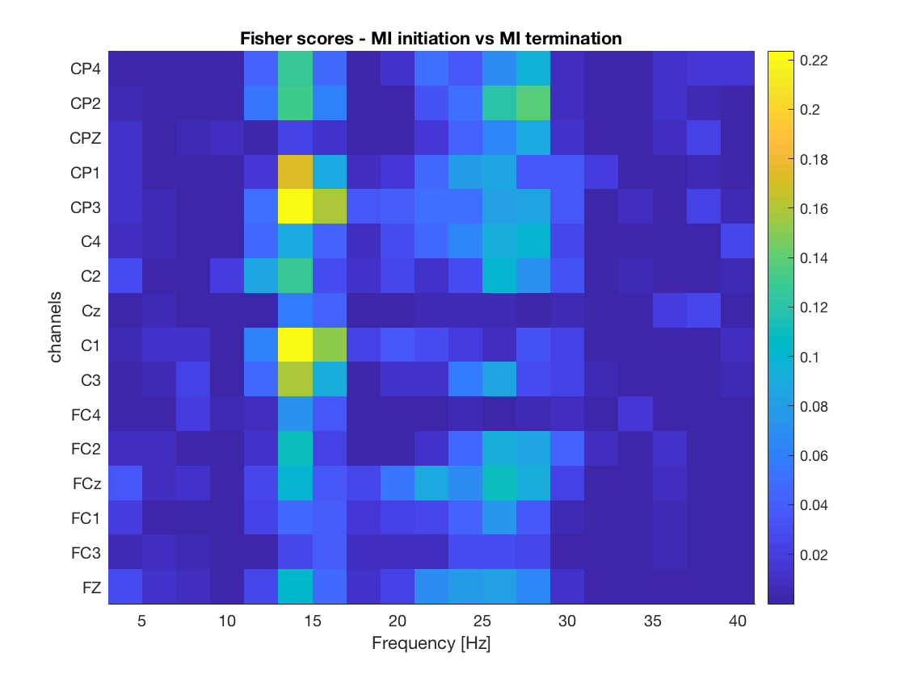
Fisher score – ak6
rankfeat on 75% (re-training on train+validation)
The most discrimant features appear to be in the mu band, for channels: C1, C3, CP1,CP3

Slide 21
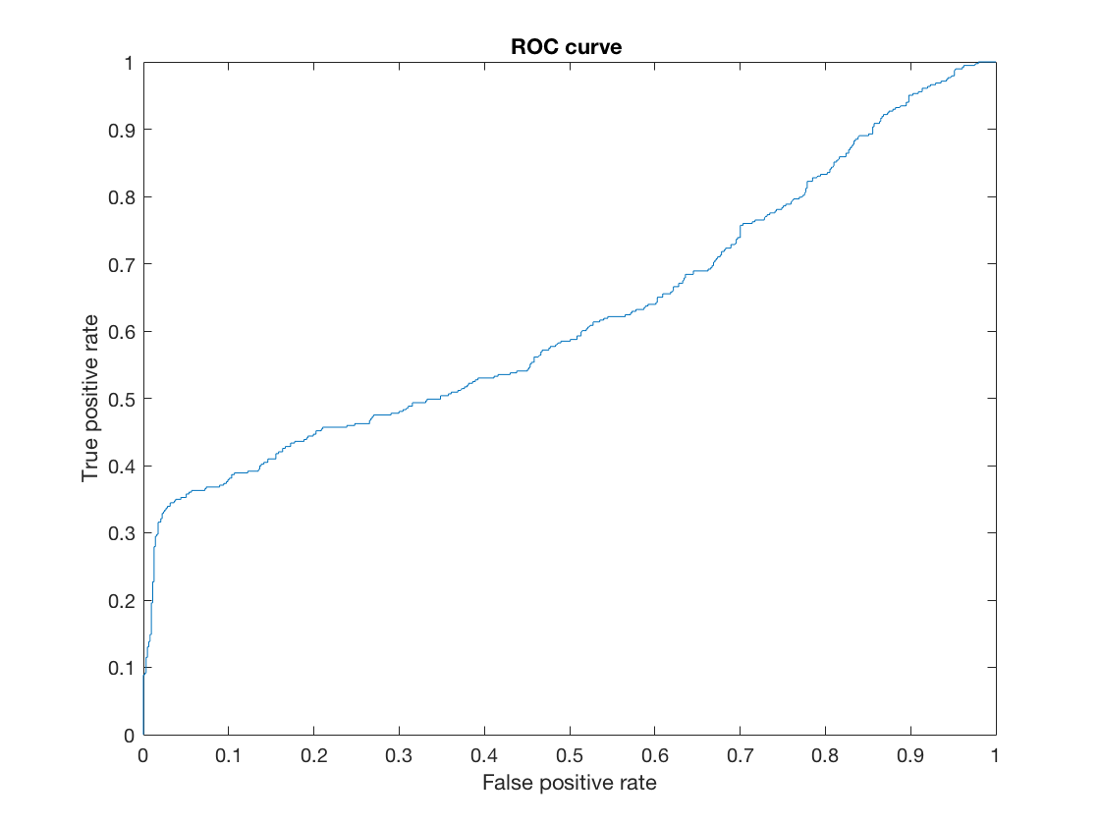
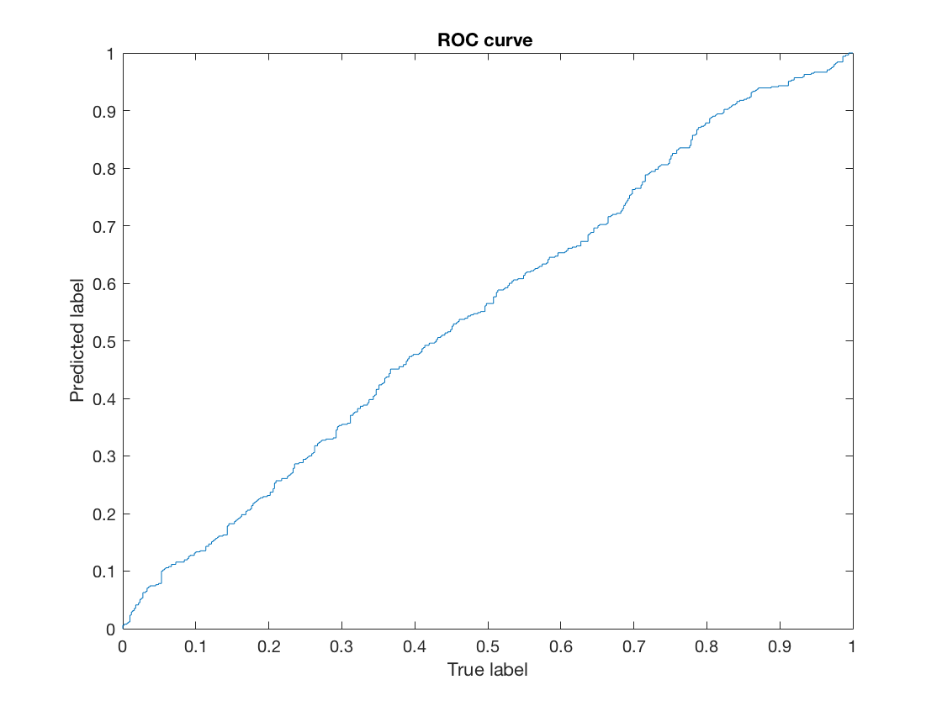
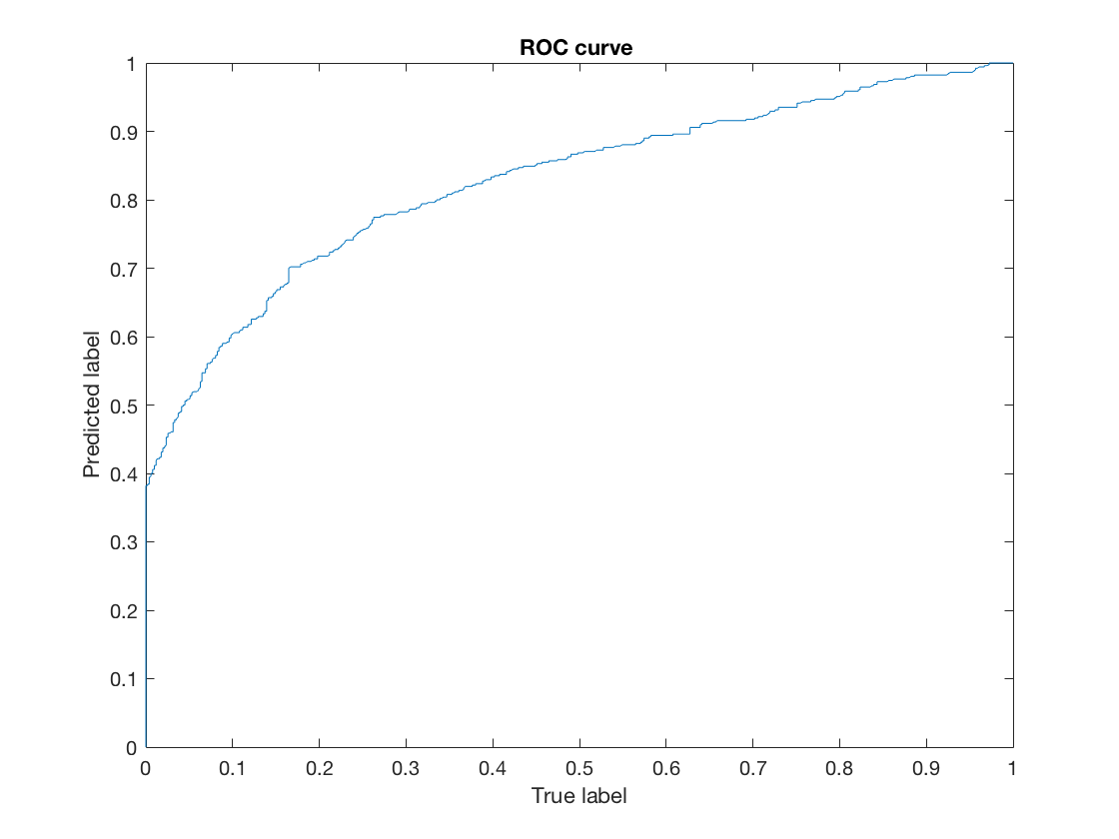
Metrics for capability assessment: ROC curves
ak4
ak5
ak6
Only the decoder for subject ak6 shows a good performance

Slide 22
Metrics for capability assessment: class error and confusion matrix
ak4
ak5
class error: 0.362
class error: 0.463
confusion matrix:
574 | 63
239 | 144
confusion matrix:
316 | 194
278 | 232
ak6
class error: 0.238
confusion matrix:
420 | 90
152 | 358

Slide 23
Discussion

Slide 24
Summary
For all the participants the channels of interest (CP3, CP4, C3, C1) have the highest activity during MI termination
Kinesthetic Motor Imagery shows for all the participants the expected pattern of brain activity
Beta rebound is almost always accompanied by mu rebound

Slide 25
Major issues encountered
The decoder shows higher performance for one participant than other one
Mean class error over CV folds with respect to the number of features shows a monotonic decreasing trend
It is possible that some problems in re-ordering the features for Fisher’s scores maps were present in the code
Epoching

Slide 26
Other approaches which could be used
Proper PCA
Mean class error over CV folds with respect to the number of features shows a monotonic decreasing trend
It was not possible to perform quadratic classifier

Slide 27
…online!
The decoder shows higher performance for one participant than other one
Mean class error over CV folds with respect to the number of features shows a monotonic decreasing trend
It was not possible to perform quadratic classifier

Slide 28
Thank you for your attention!
Any questions?

Slide 29
Additional results

Slide 30
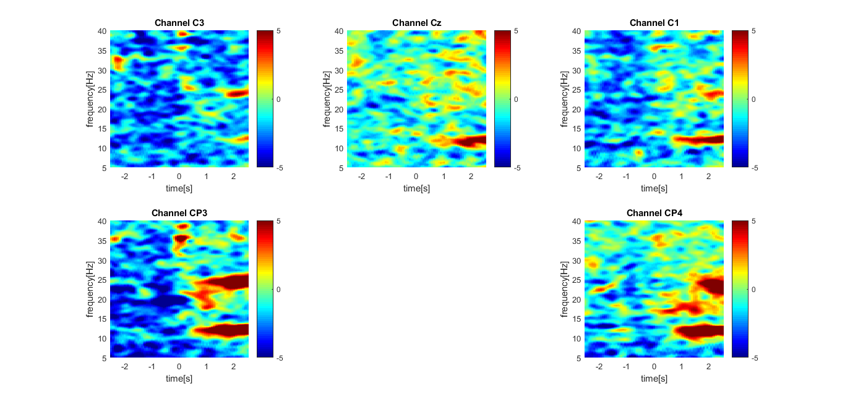
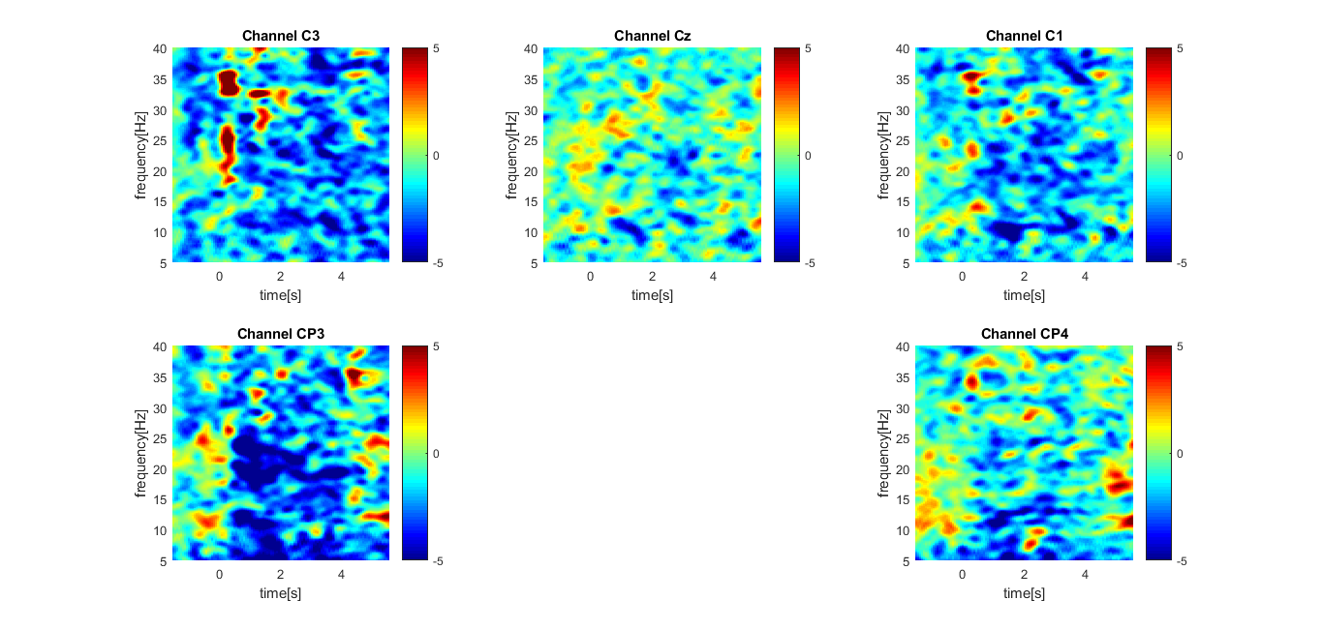
Spectrogram offset and onset CAR - ak5

Slide 31
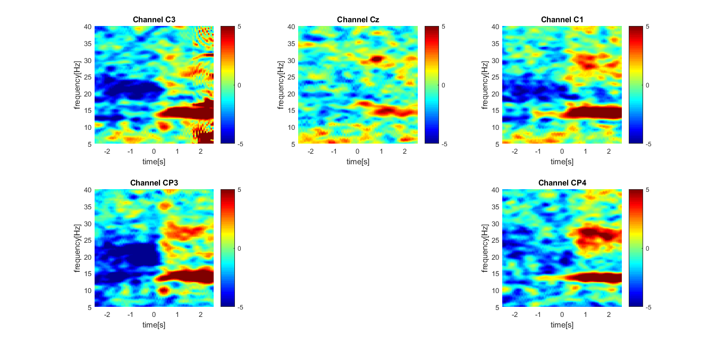
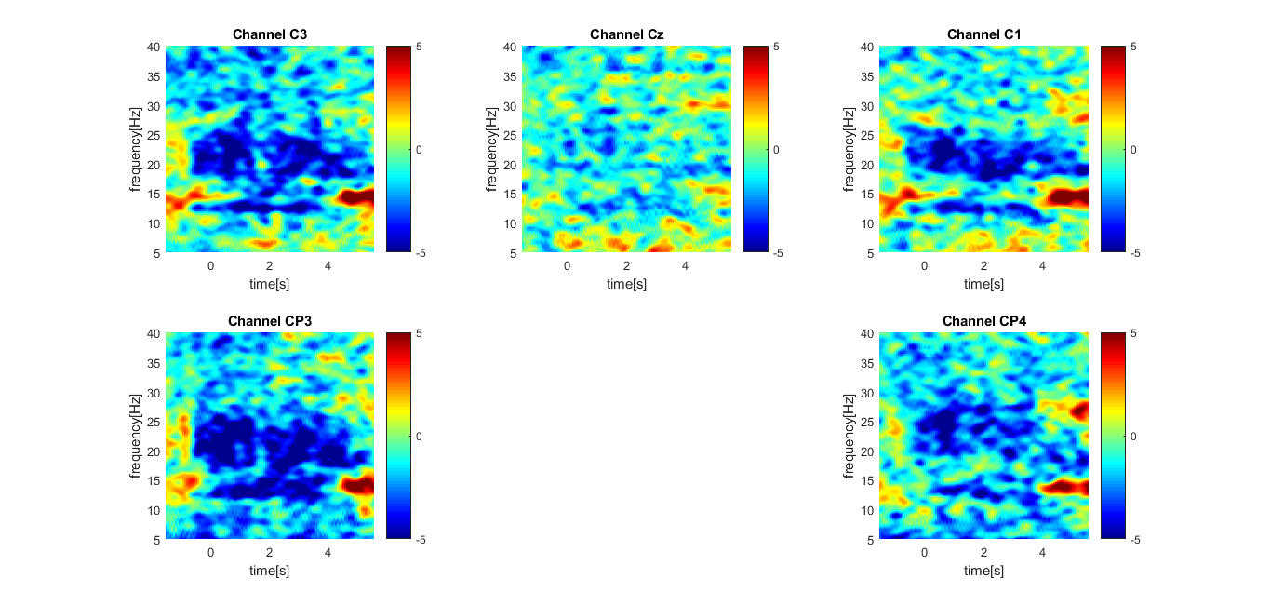
Spectrogram offset (left) and onset (right) CAR - ak6

Slide 32
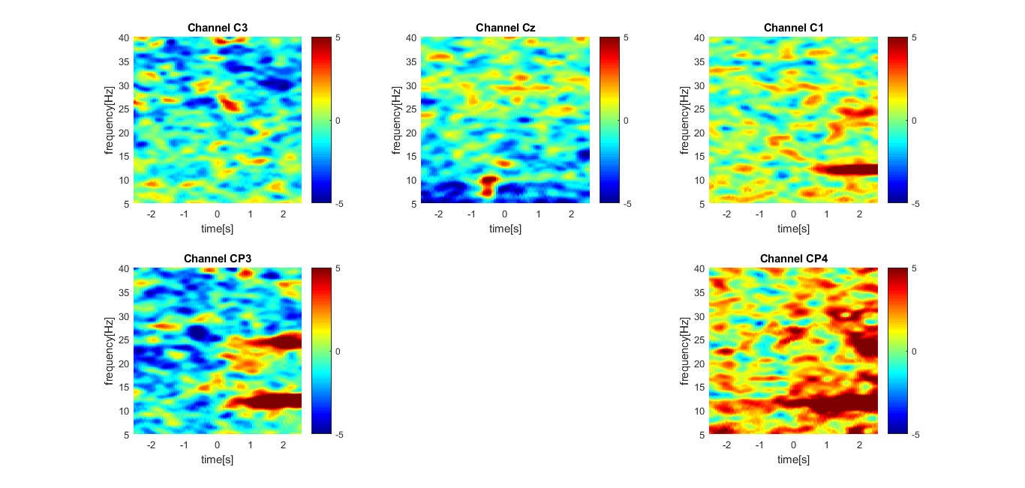
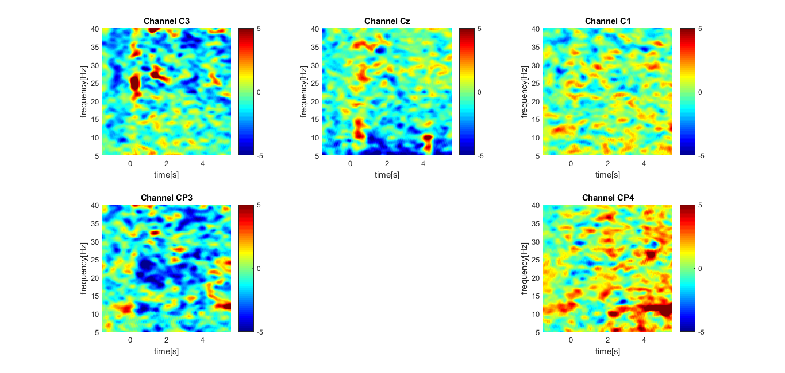
Spectrogram offset and onset Laplacian - ak5

Slide 33
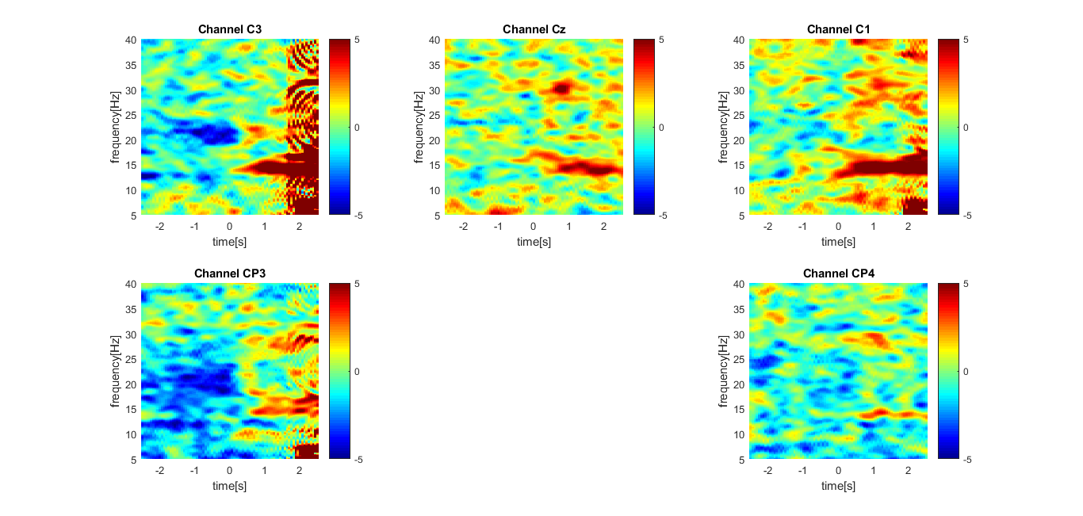
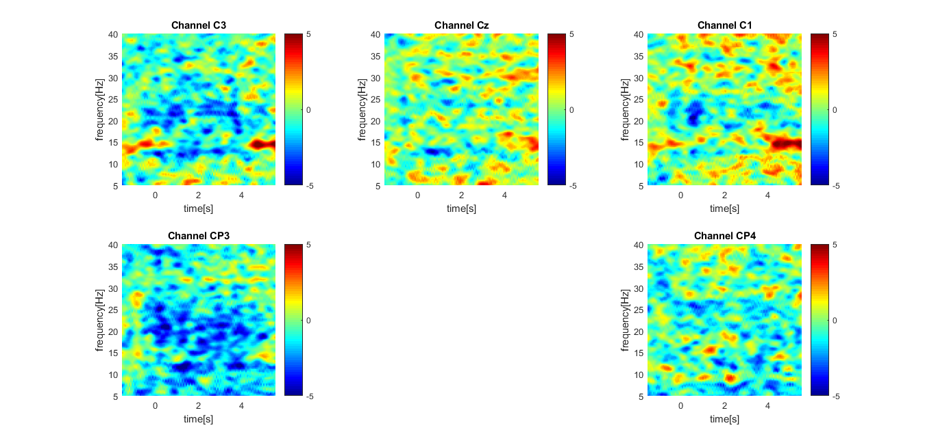
Spectrogram offset and onset Laplacian - ak6

Slide 34
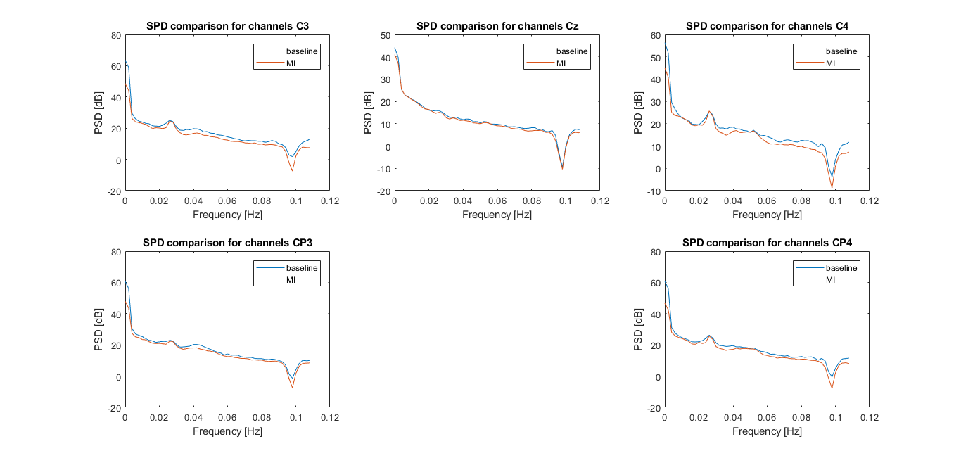
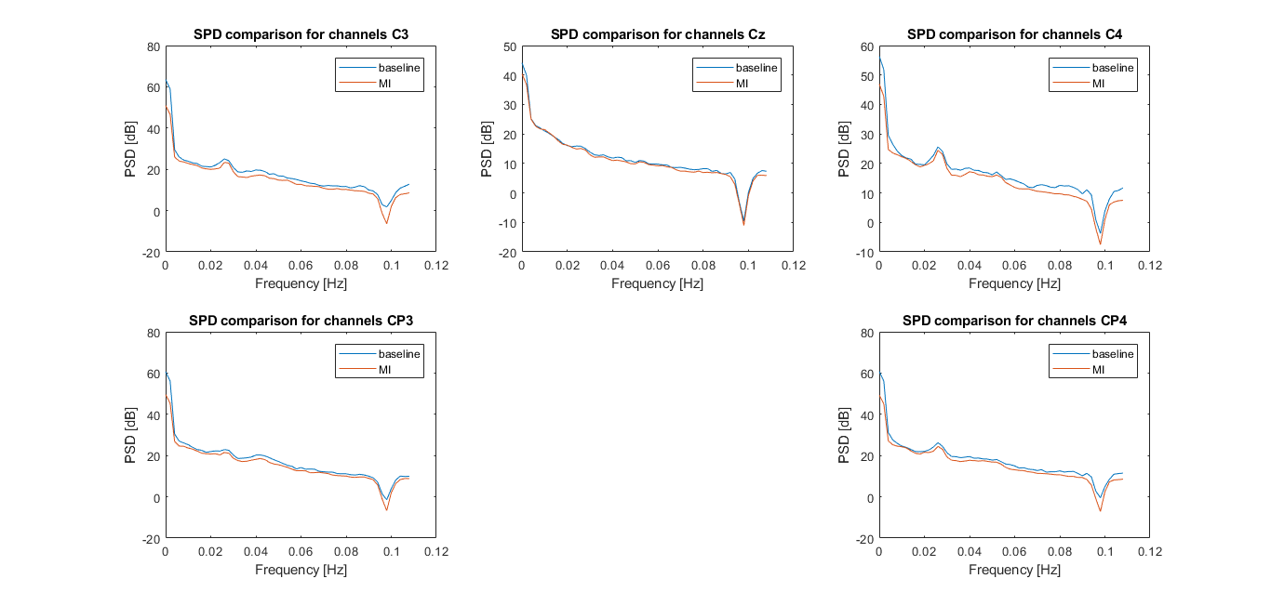
Periodogram (Pwelch) offset/onset ak6

Slide 35
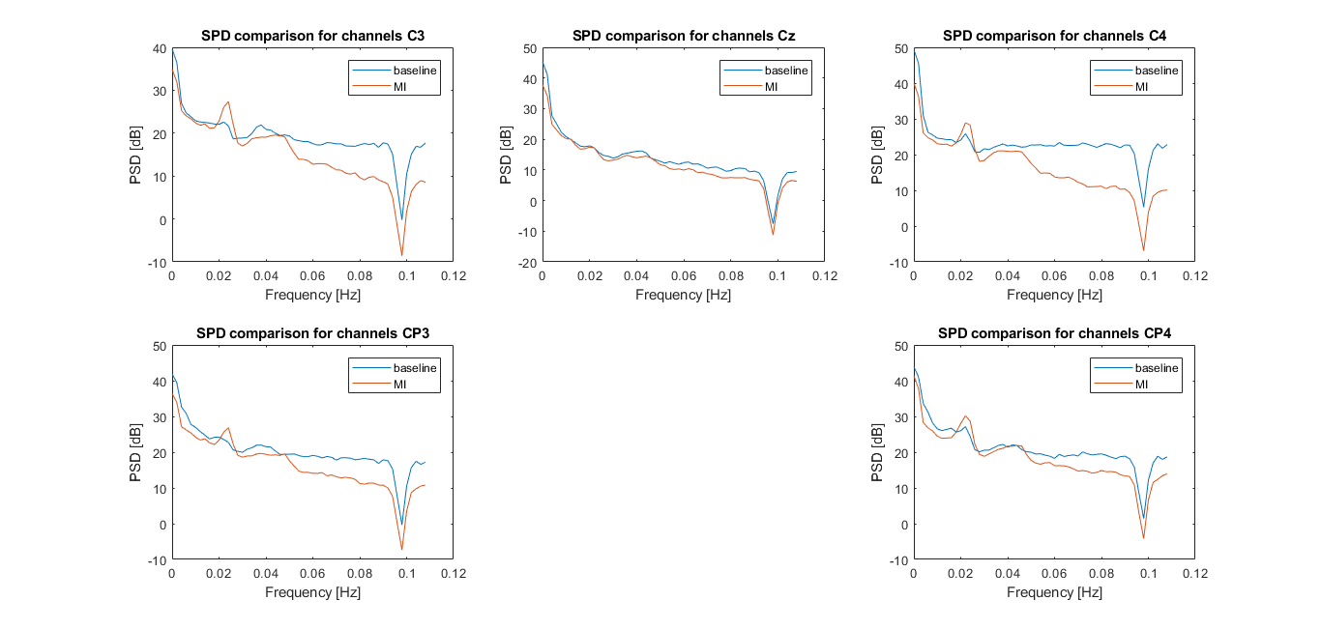
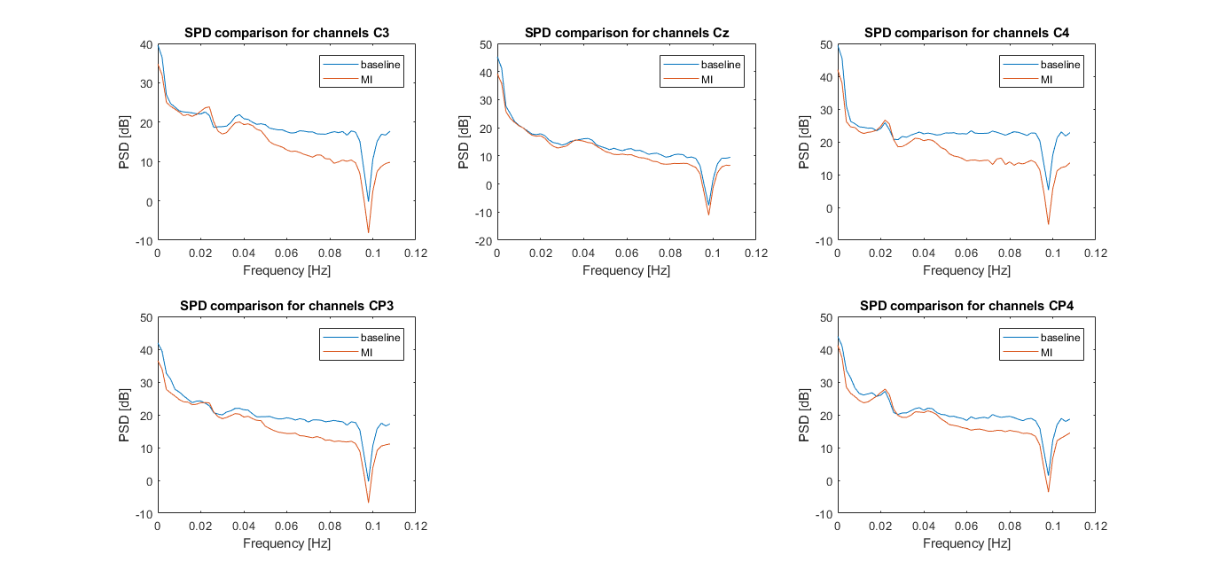
Periodogram (Pwelch) offset/onset ak4

Slide 36
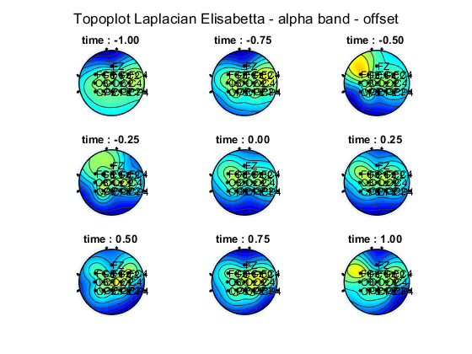
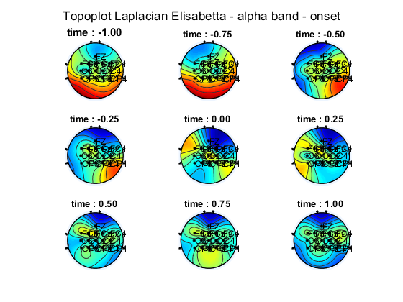
Topoplot alpha band - ak6

Slide 37
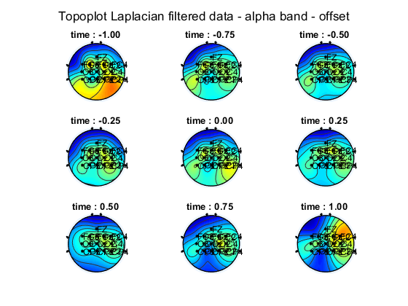
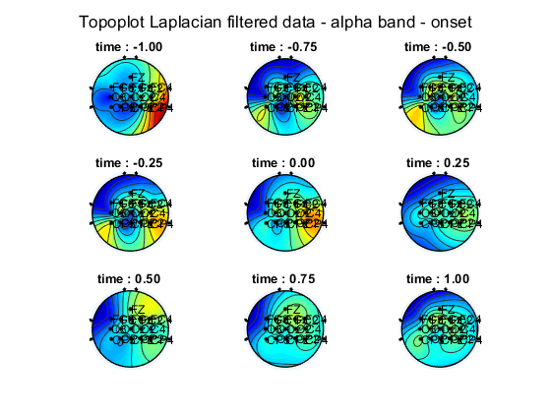
Topoplot alpha band - ak5

Slide 38
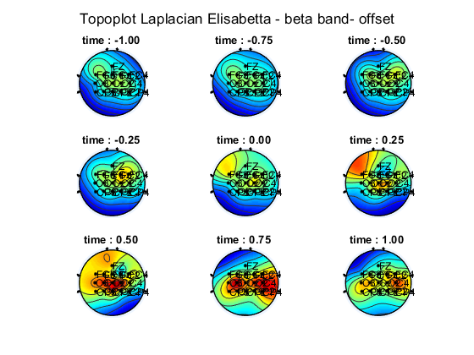
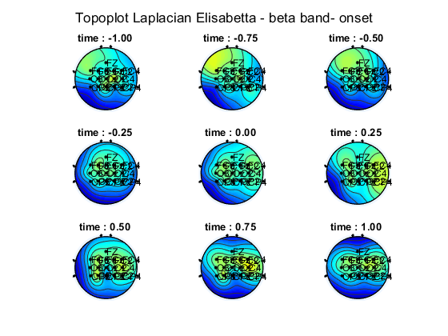
Topoplot beta band - ak6

Slide 39
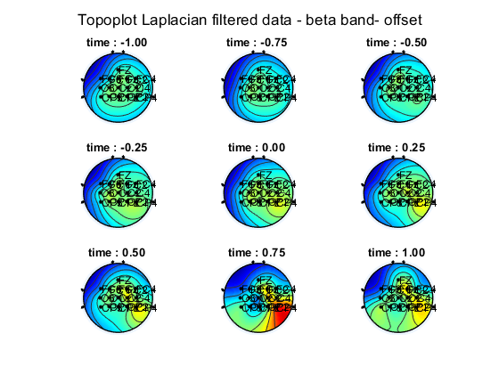
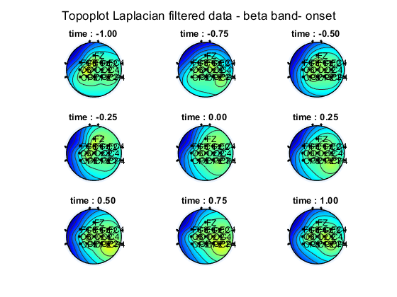
Topoplot beta band - ak5

Slide 40
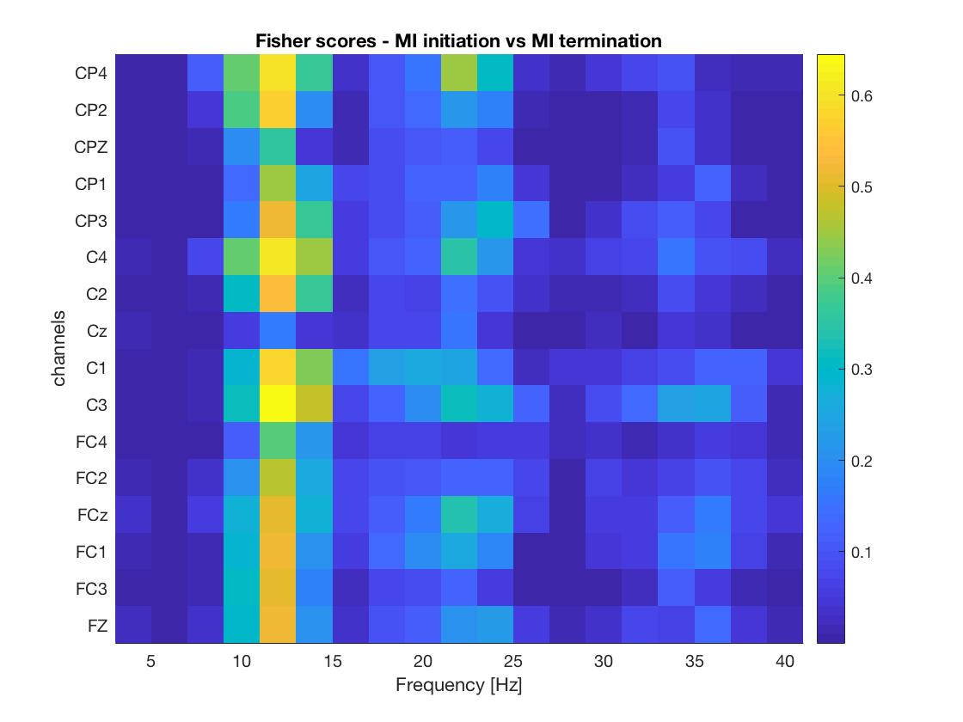
Fisher score – ak4

Slide 41
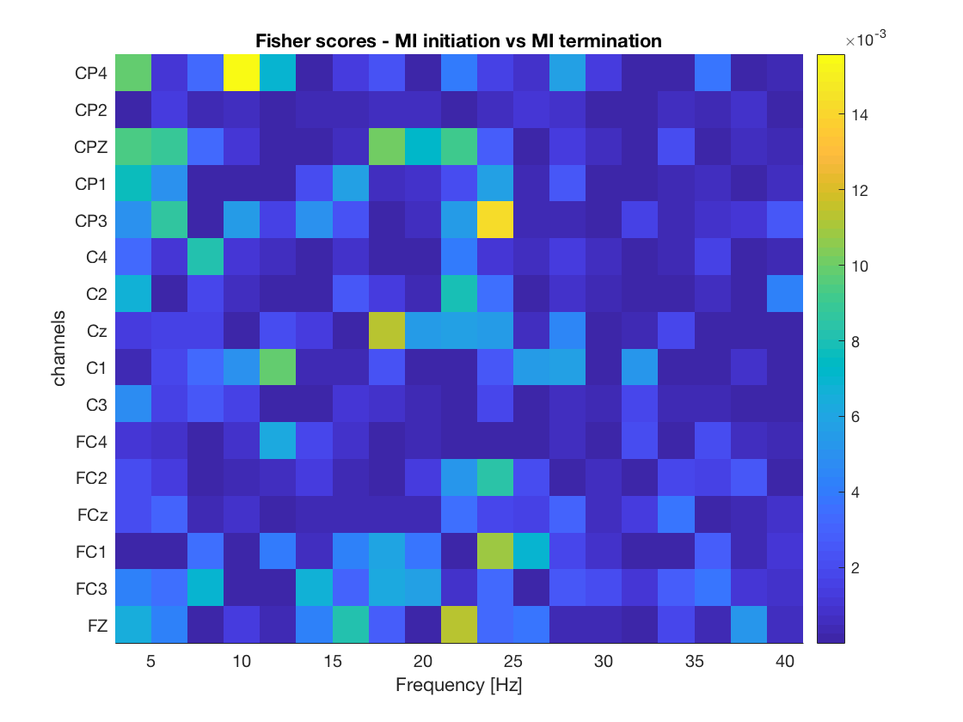
Fisher score – ak5

Slide 42
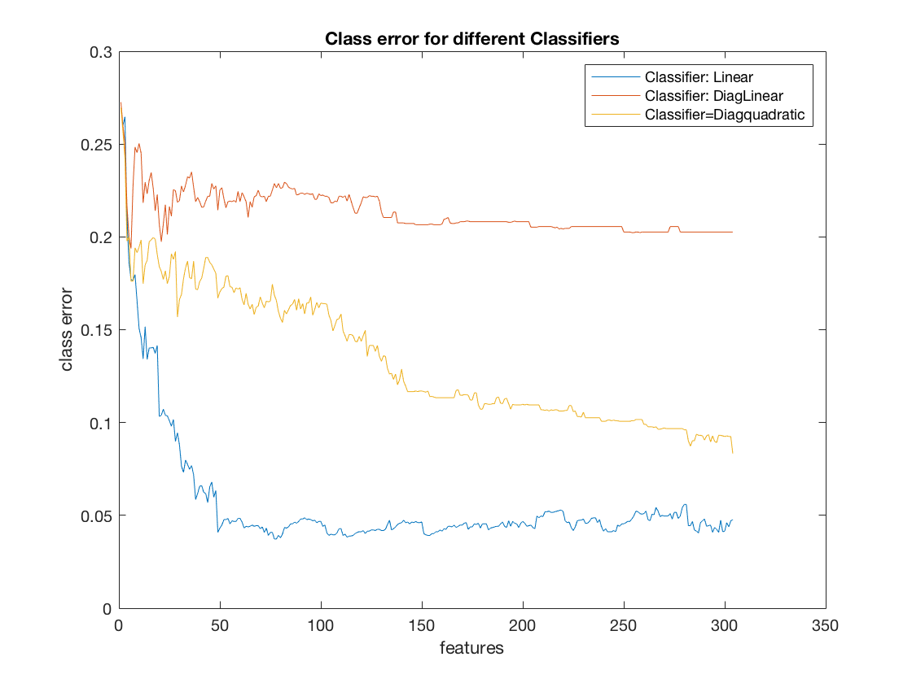
Class errors on CV folds – ak 5

Slide 43
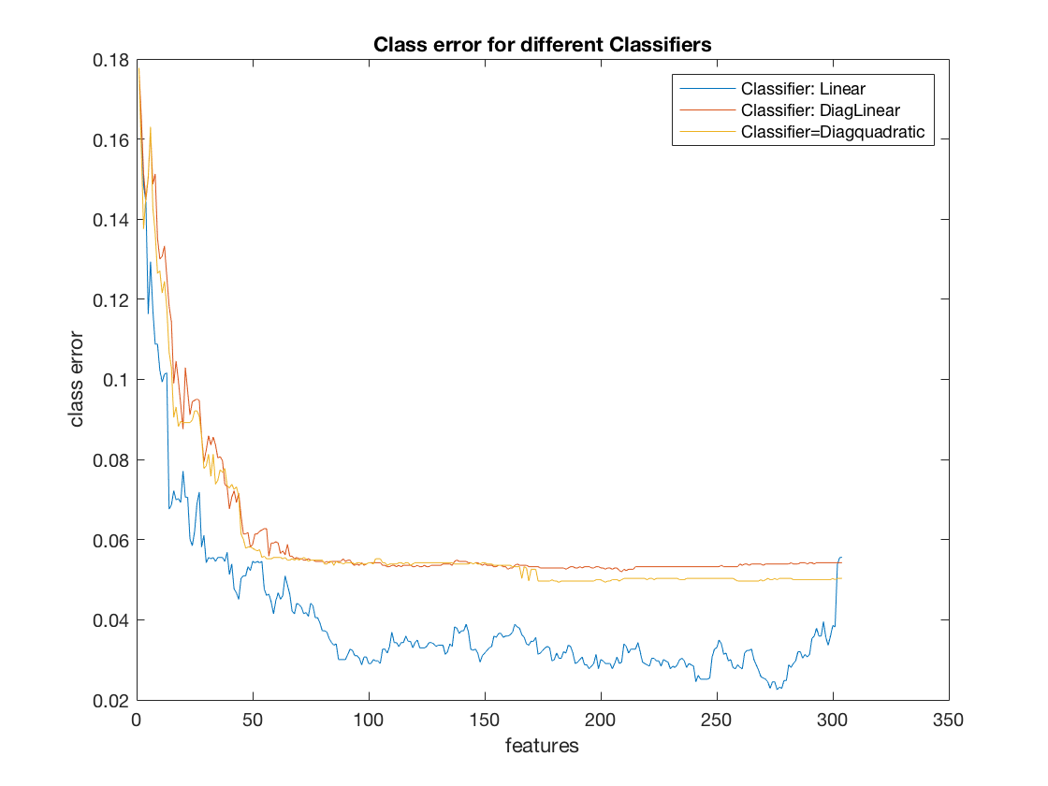
Class errors on CV folds – ak 6

